Slide 1
#73 Gamification-based education platform
for sustainable agricultural and environmental applications
David Huang & Jesse Zeng
David Huang & Jesse Zeng
Notes:
Good morning, my name is Jesse and this is my partner David. We are doing project #73 which is about developing a gamification based education platform for sustainable agriculture and environmental applications.

Slide 2
Sustainability
Why sustainability?
What has been done?
Focusing on spreading awareness and empowering people on an individual level
Using technology to teach knowledge and skills
Icon - FlatIcon
Notes:
Firstly, why sustainability? As the world population continues to grows, more resources such as food and water are required support growth. However resources and land are limited. So what has been done? Changes have been made on a government level such as banning of single use plastic bags and water restrictions. Our project focuses on spreading awareness on the individual level to empower people to make change. We will use technology and gamification to teach knowledge and skills to people.

Slide 3
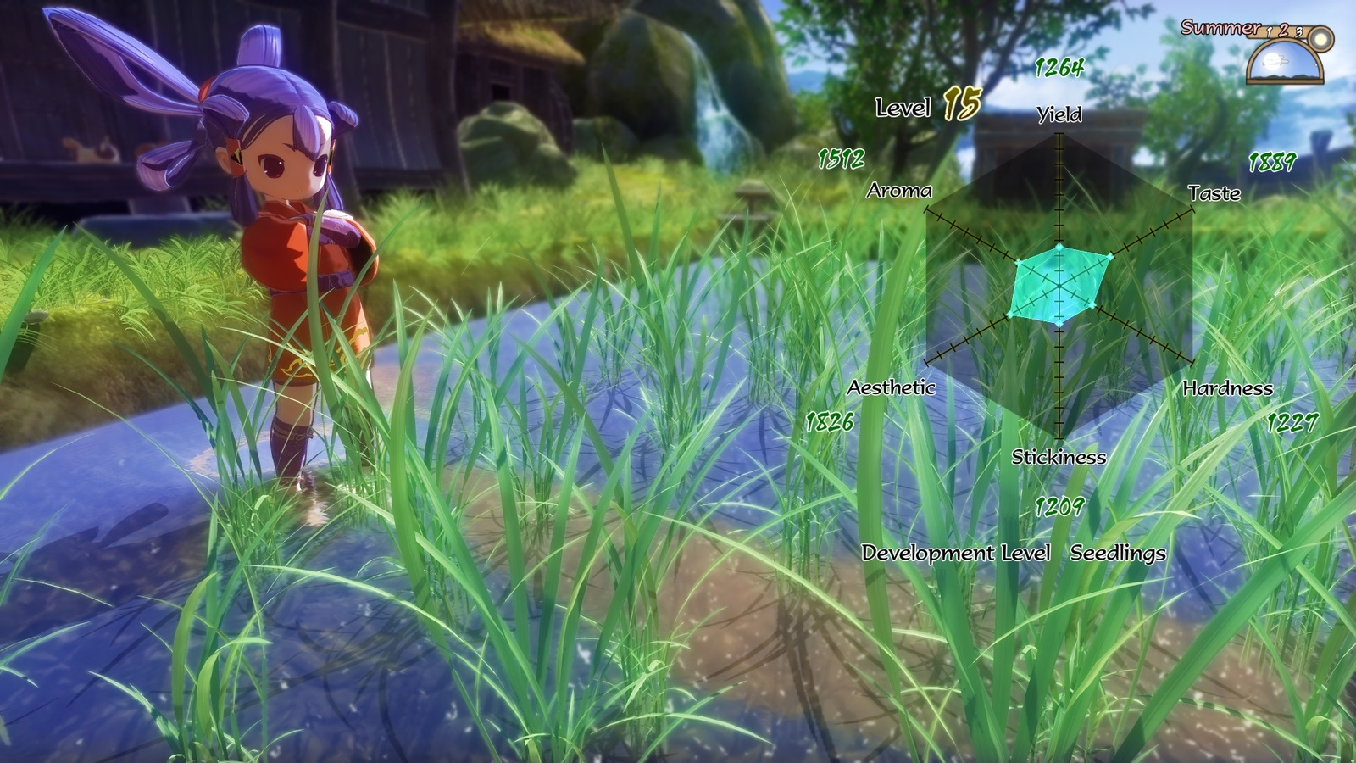
What is Gamification?
Gamification
“The use of game design elements in non-gaming contexts.” ¹
e.g. Points accumulation for using public transport
Serious Games
"Games that do not have entertainment, enjoyment, or fun as their primary purpose." ²
Educational
Rewarding
Sakuna: Of Rice and Ruin (2020) [Video Game]
[1] S. Deterding, R. Khaled, L. Nacke and D. Dixon, "Gamification: Toward a definition", 2011.
[2] D. R. Michael and S. L. Chen, Serious Games: Games That Educate, Train, and Inform
Notes:
What is gamification? Gamification is the use of game design elements in non-gaming contexts. It entices people to do tasks or actions they otherwise may not do.
An example of this is through rewarding users with points for using public transport instead of driving their car. Within gamification there is a subgroup of serious games.
Serious games are games that do not have entertainment, enjoyment or fun as their primary purpose. The main purpose is to be educational in teaching knowledge and skills. But they are also designed to be fun and entertaining in order to motivate the player.
The image shows an educational part of a game about growing rice. The player grows rice over several seasons and gets rewards and levels depending on the quality of the rice.
During our research we found that there are attributes that define a successful gamification.

Slide 4
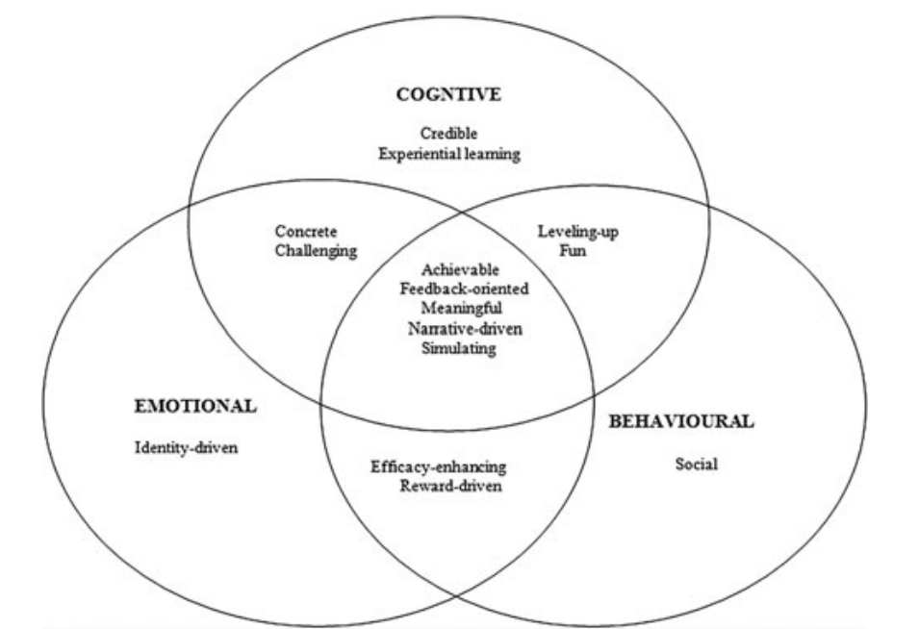
Games Framework
Cognitive engagement: Challenging the player’s mind through learning
Emotional engagement: Invoking the player’s feeling towards the problem and connection to personal experiences
Behavioural engagement: Encouraging behavioural changes through empowerment or social pressure
T. Ouariachi, M. Olvera-Lobo, J. Gutiérrez-Pérez and E. Maibach, "A framework for climate change engagement through video games", Environmental Education Research, vol. 25, no. 5, pp. 701-716, 2018.
Notes:
We discovered a gamification framework that proposed elements of successful user engagement in educational games. The games framework splits a number of attributes into 3 types of engagement. Cognitive engagement relates to the learning aspects of the game such as knowledge and method of learning. Emotional engagement relates to the problem the at hand and how the player can connect with the game. Lastly, behavioural engagement relates to encouraging behavioural change through empowerment or social pressure from others. We used these attributes as a base to define what we’re looking for in our literature review.

Slide 5
Applying the Gamification Framework
Credible knowledge
Experiential learning
Simulating
Rewards driven
Social Interaction
Icons - FlatIcon
Notes:
We analysed our literature review using these 5 attributes.
Credible knowledge should be presented to the user for accurate learning.
Users should be able to learn through experience, trial and error.
The design should allow users to simulate actions that they cannot do in real life. as simulation will relate actions to consequences to enforce learning
Reward driven is an important factor to motivate the user and increase participation.
And social interaction is good for user validation and peer pressure.

Slide 6
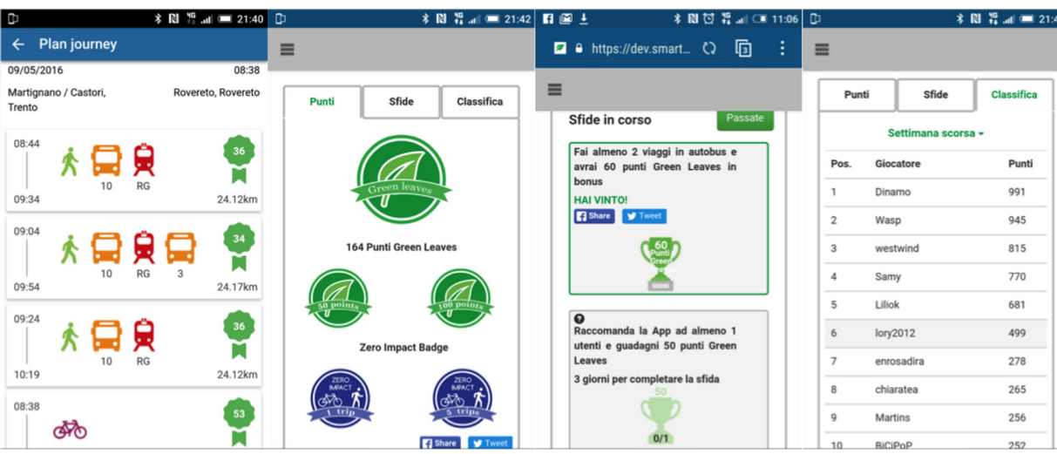
Literature Review (1)
Points Accumulation Application
Changing transport behaviours to be sustainable
Sharing of data for agricultural productivity
Data collection for statistics of agricultural yield
R. Kazhamiakin, A. Marconi, A. Martinelli, M. Pistore and G. Valetto, "A gamification framework for the long-term engagement of smart citizens", 2016 IEEE International Smart Cities Conference (ISC2), 2016.
Notes:
We split the literature review analysis into 3 different types of gamification design. The first design is a points accumulation app. These apps reward points to users for doing task such as sharing data or completing challenges. The image shows a points app for sustainable transport. Green leaves are rewarded for taking the bus and train rather than driving. Leaves can be exchanged for physical discounts or rewards. Users can share their progress on social media and there is a leaderboard showing the top user.

Slide 7
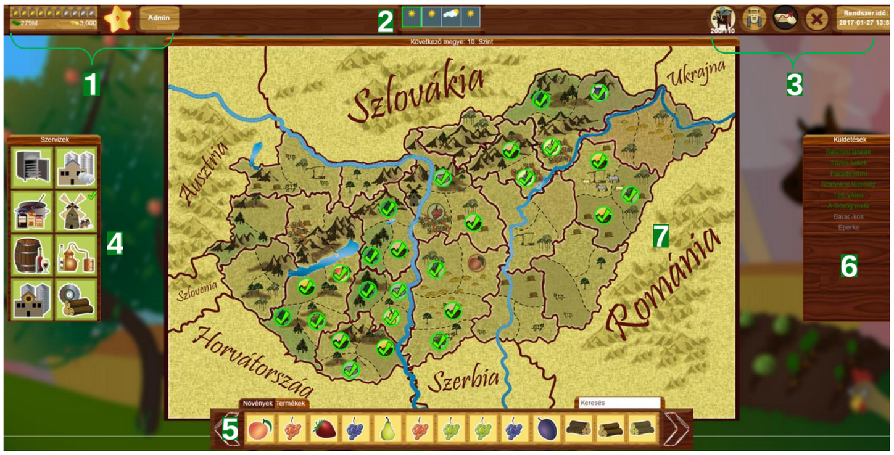
Literature Review (2)
Simulation Game
Model of a physical area to see environmental impacts
Educate and introduce players to farming
Virtual weather system
R. Szilágyi, T. Kovács, K. Nagy and L. Várallyai, "Development of Farm simulation application, an example for gamification in higher education", Journal of Agricultural Informatics, vol. 8, no. 2, 2017.
Notes:
The second design is a simulation game. These games create a virtual environment representing reality that allows users to experience things they may not in real life. For example seeing environmental impacts by changing business practices. The image shows a simulation game where players are introduced to farming. Players grow crops which are subjected to weather conditions.

Slide 8
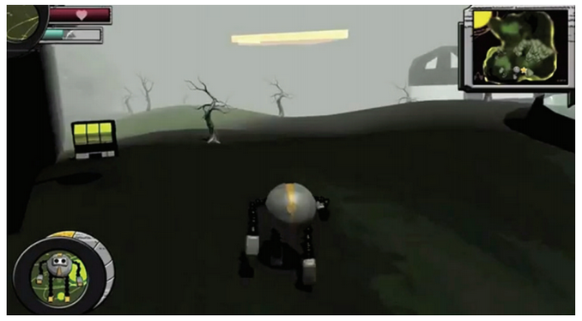
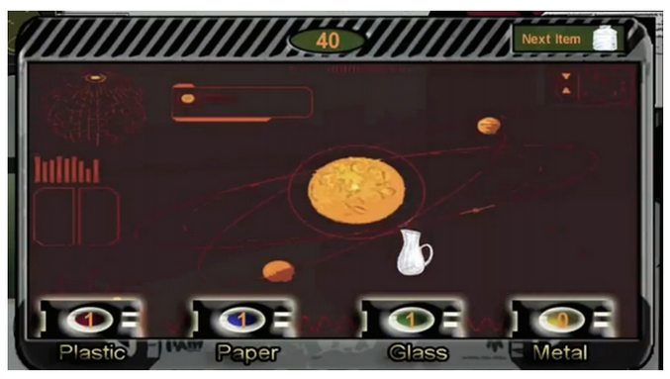
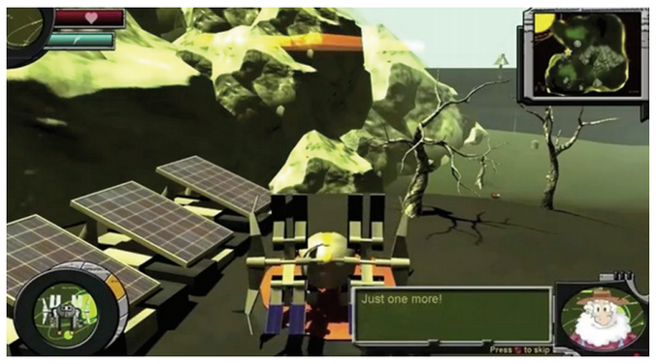
Literature Review (3)
Role Playing Game
Understanding sustainable building concepts and practices
Story based game that teaches cleaning up the environment and recycling
A. Barbosa, P. Pereira, J. Dias and F. Silva, "A New Methodology of Design and Development of Serious Games",
International Journal of Computer Games Technology, vol. 2014, pp. 1-8, 2014.
Notes:
The final design is a role playing game. These games give the player a role and have levels to go through where they learn progressively. An example of a role playing game are shown in the images. On the top right show a wasteland that the player has to clean up. The bottom right shows a brighter world that is the result of cleaning and using renewable energies. Mini games are also used to teach skills such as recycling. Now I will pass on to my partner David who will begin with the analysis of the literature review.

Slide 9
Literature Review Analysis
Points Collection Application
Common
Reward driven
Unique
Physical rewards (e.g. coupons)
Missing
Experiential learning
Adapting to real world variables
Simulation Game
Common
Reward driven
Credible Knowledge
Experiential learning
Unique
Simulating
Missing
Social interaction
Realism
Role Playing Game (RPG)
Common
Reward driven
Credible Knowledge
Experiential learning
Unique
Diverse education tools e.g storytelling, puzzles
Missing
Social interaction
Realism
Notes:
From the literature review examples, we can see a comparison of the common, unique and missing features of the models.
For the common features, all models have reward driven as it increases the player’s engagement and motivation.
However, only simulation and role playing game contains Credible knowledge and Experiential learning as players need to learn through trial and error.
For the unique features, points collection app entices its players with physical rewards, such as coupons.
As for simulation they have simulating features and RPG’s have various educational tools to increase user engagement.
For the missing features, points collection app lacks experiential learning since it does not prioritise education but rather encourages more sustainable behaviours.
Moreover, it does not account for real world variables where the app will still encourage users to bike or walk, even in bad weather conditions.
Both simulation and role-playing game have no social interaction due to games being single player. The models also lack realism as they solely rely on a web or software application, that only deals with the virtual space . Although realism is not stated in the games framework due to inadequate technologies, we believe current technology can achieve realism.

Slide 10
Gaps in Current Research
Realism
Lack of realism
“It’s only a game”
Knowledge and skills presented may not transfer to real life
Icon - FlatIcon
Notes:
Why is realism important? Well what happens if realism is not achieved?
Players may see the game as “It’s only a game.’ Players may not the take the game seriously and does not experience real-world constraints. For example, players may find loopholes that achieves the game’s purpose but not applicable to real world.
The result? Knowledge and skills presented in the game may not be transferable to real life, causing a lack of genuine learning for players.

Slide 11
Gaps in Current Research Topics
Sustainability in Agriculture
Current research targets other sustainability areas or only agricultural knowledge
Lack of studies in gamification of sustainable agriculture
Sustainable agriculture is essential
70% of global freshwater is used for agriculture ¹
78% of polluted waterways with nutrient rich pollutants are caused by farming ¹
[1] H. Ritchie and M. Roser, "Environmental impacts of food production", Our World in Data, 2021. [Online]. https://ourworldindata.org/environmental-impacts-of-food.
Icon - FlatIcon
Notes:
In terms of learning, the studies in our literature review only focuses on either gamifying sustainability or agriculture. We noticed there is a lack of research in using gamification to educate users about sustainable agriculture.
Why is this a problem? Well
70% of global freshwater is used for agriculture
78% of polluted waterways with nutrients are caused by farming
As you can see, agriculture waste is a significant issue we have to face in the future especially as human population growth increases substantially each year.

Slide 12
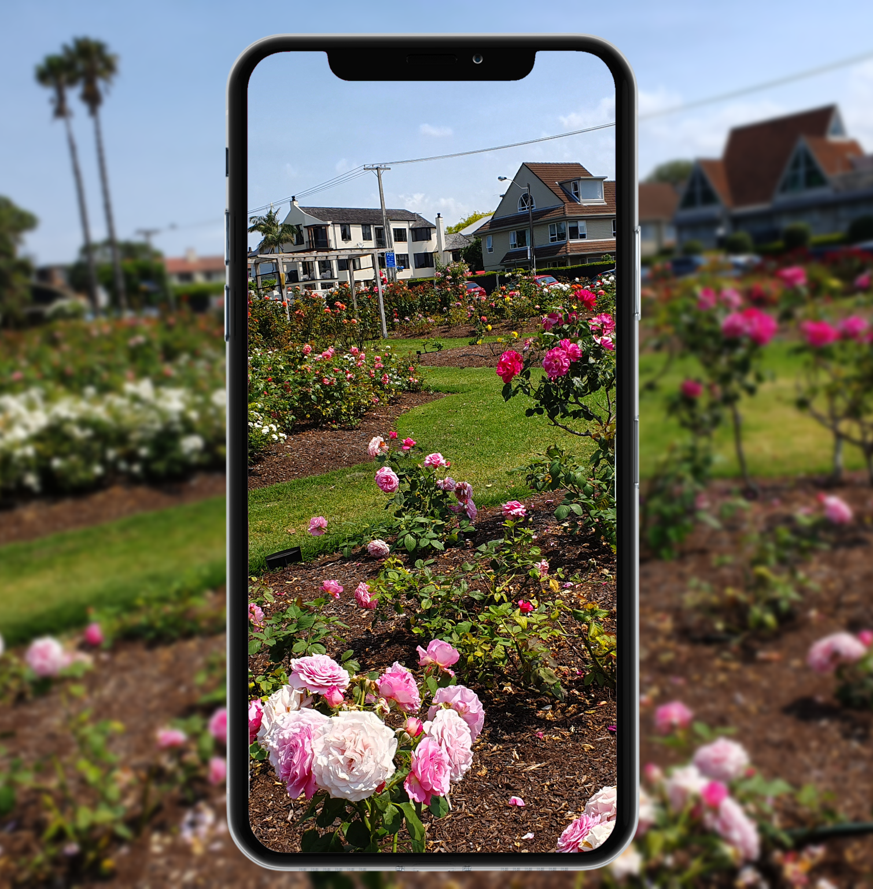
Research Intent
Augmented Reality (AR) Based Game for Sustainable Agriculture
Notes:
The solution? We proposed an Augmented reality (AR) app where players can learn about sustainable agriculture.
AR technology can close the gap between the virtual world and the physical space, thus solving the lack of realism in games. For example, the virtual space can provide virtual props, points and leaderboard systems while the physical world makes the game more realistic.
Combining AR technologies and sustainable agriculture knowledge, players are encouraged to step away from their computers and into their gardens to start farming. The consequence of being outside will create a more realistic learning experience for players while (IoT) data such as weather could be implemented so players are confronted with the real world constraints of farming.
If the players are physically and actively engaged, we hope the app will have a significant impact on players behaviours such as using less water in their daily lives.

Slide 13
Research Objectives
01
02
03
Knowledge
Realism
Behaviour
Spread knowledge about sustainable agriculture
Create a realistic learning environment for real world engagement
Include transferable sustainable agricultural practices e.g saving water
Notes:
In summary, these are the three research objectives we desire to achieve in our final product.
These are Knowledge, Realism and Behaviour. First we want to spread sustainable agricultural knowledge to players. However in order to do that, we need the game to be more realistic in order to provide a realistic learning environment for players.
At the end, we hope players behaviours will be influenced by our app where they will receive transferable sustainable agricultural practices such as saving more water in their day to day lives.

Slide 14
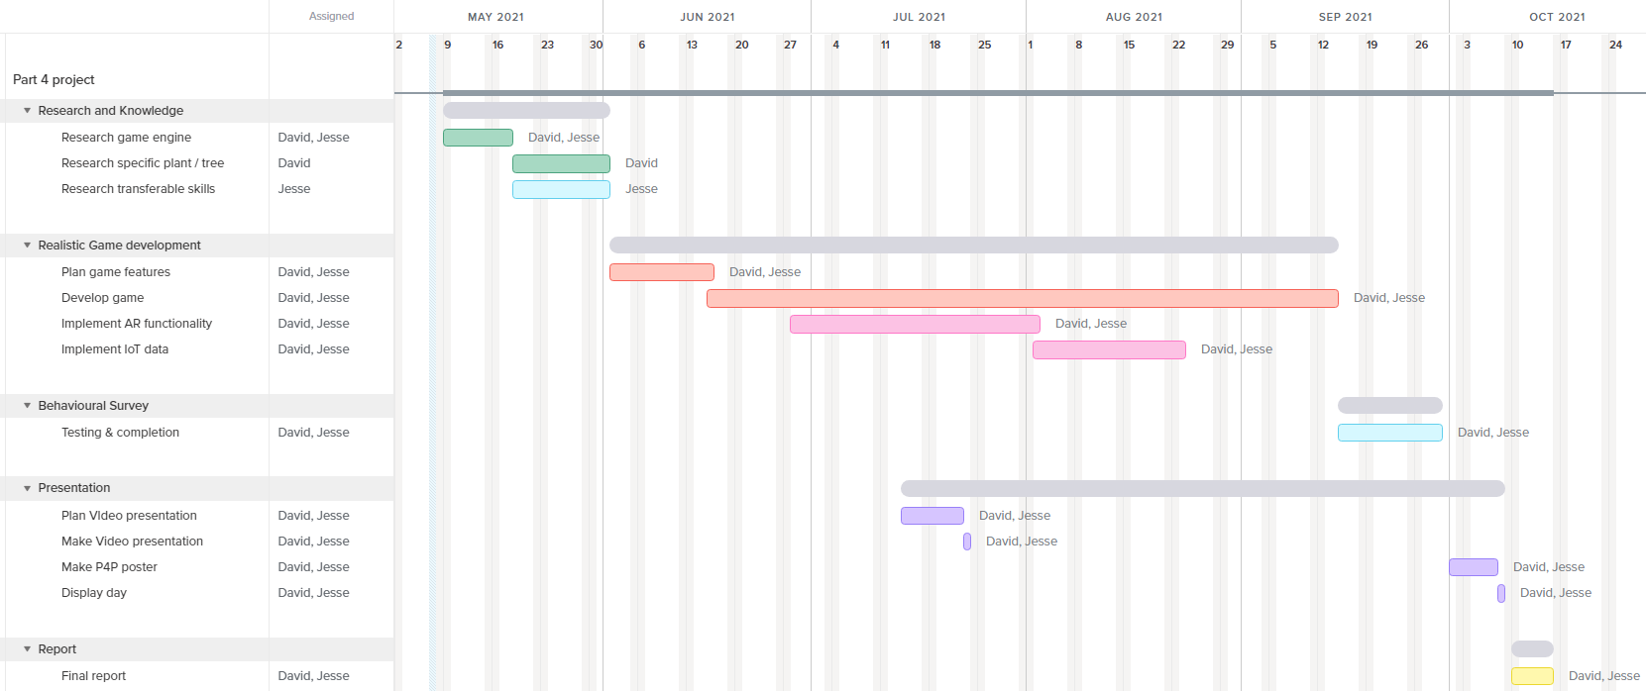
Project Plan
Notes:
In order to achieve our three objectives, this is our project plan.
First, we must extensively research sustainable agriculture methods and knowledge so we pass on valuable knowledge to players.
Secondly, we plan and implement our app by utilising AR technology and IoT data to create a realistic learning environment for the player to interact with.
Finally, in order to observe the behaviour impacts on the player, we intend to give players a behavioural survey about their experiences with the game and what behavioural changes they experienced in their lives after using it.
The other plans such as the presentation and report will follow after development.
Thank you for listening.

